Slide 1

Applied Machine Learning (BUAN 6341) Lecture Linear Models
Harpreet Singh
University of Texas at Dallas
Fall 2023

Slide 2
Acknowledgement
Python Code for this presentation will be available on eLearning – code_presentation.ipynb (next lecture)
code_presentation.ipynb- The source code for this file is adapted from git hub repository of chapter 4 of the book
Hands-on Machine Learning with Scikit-Learn, Keras and TensorFlow
Git hub of book - https://github.com/ageron/handson-ml2

Slide 3
Linear Regression

Slide 4
Linear Regression – 1 output, 1 input
Predicts a quantitative response Y as a function of predictor variable X
Assumes there is approximately a linear relationship between X and Y
Mathematically: ${{Y ≈θ}_{0}+ θ}_{1}X$
Mathematically: 〖〖𝑌 ≈𝜃〗_0+ 𝜃〗_1 𝑋
Parametric model: model coefficients or parameters • $θ_{0}$intercept • $θ_{1}$slope
Parametric model: model coefficients or parameters • 𝜃_0 intercept • 𝜃_1 slope

Slide 5
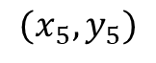
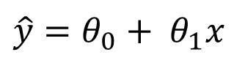
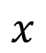
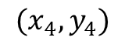
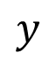
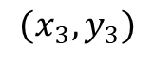
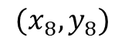
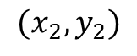
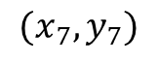
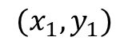
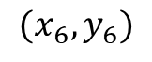
Linear Regression – 1 output, 1 input
$$y$$
$$(x_{8},y_{8})$$
$$(x_{6},y_{6})$$
$$(x_{7},y_{7})$$
$$(x_{4},y_{4})$$
$$(x_{5},y_{5})$$
$$(x_{2},y_{2})$$
$$(x_{3},y_{3})$$
$$(x_{1},y_{1})$$
$$x$$
Model:
$$\hat{y}={θ_{0}+ θ}_{1}x$$

Slide 6
Math (Linear Regression)
Linear relationship: outcome (dependent/criterion) variable is a linear combination of predictor (independent) variables.
$$Y=β_{0}+β_{1}X_{1}+β_{2}X_{2}+…+β_{n}X_{n}+ε$$
Outcome
Intercept
Coefficients
Predictors

Slide 7
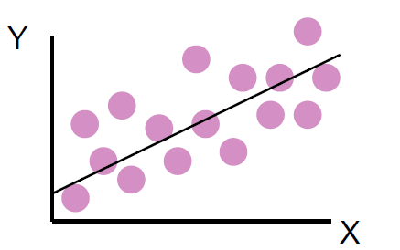
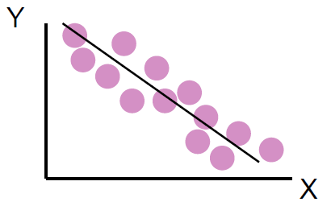
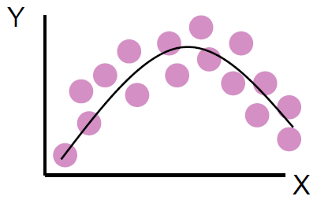
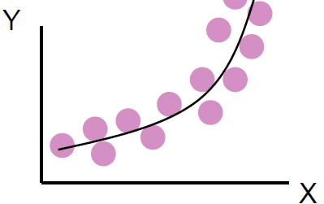
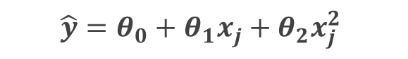
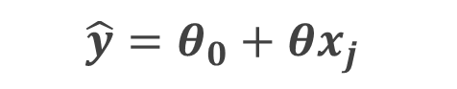
Linear Model?
$$\hat{y}=θ_{0}+θx_{j}$$
$$\hat{y}=θ_{0}+θ_{1}x_{j}+θ_{2}x_{j}^{2}$$
A linear model means linear in parameters (not X)!

Slide 8
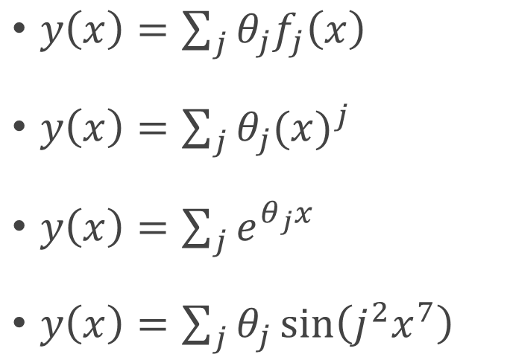
Linear Regression?
$y\left(x\right)=\sum_{j}{{θ_{j}f}_{j}\left(x\right)}$
$y\left(x\right)=\sum_{j}{θ_{j}{(x)}^{j}}$
$y\left(x\right)=\sum_{j}{e^{θ_{j}x}}$
$y\left(x\right)=\sum_{j}{θ_{j}\sin\left(j^{2}x^{7}\right)}$

Slide 9
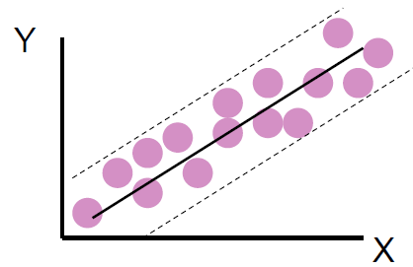
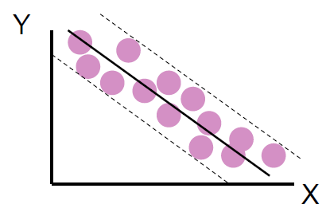
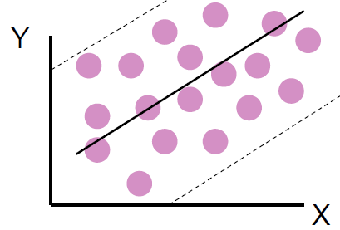
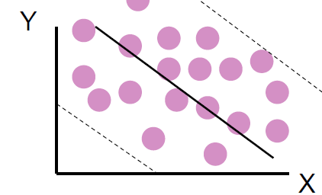
Linear Model?
Strong relationship
Weak relationship
How to evaluation?

Slide 10
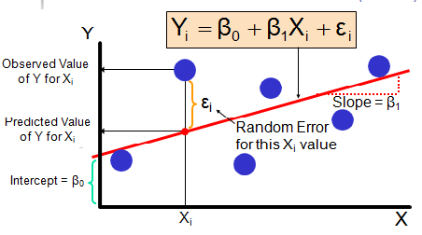
Linear Model Evaluation
Residuals e = observed (y) – predicted (y)

Slide 11
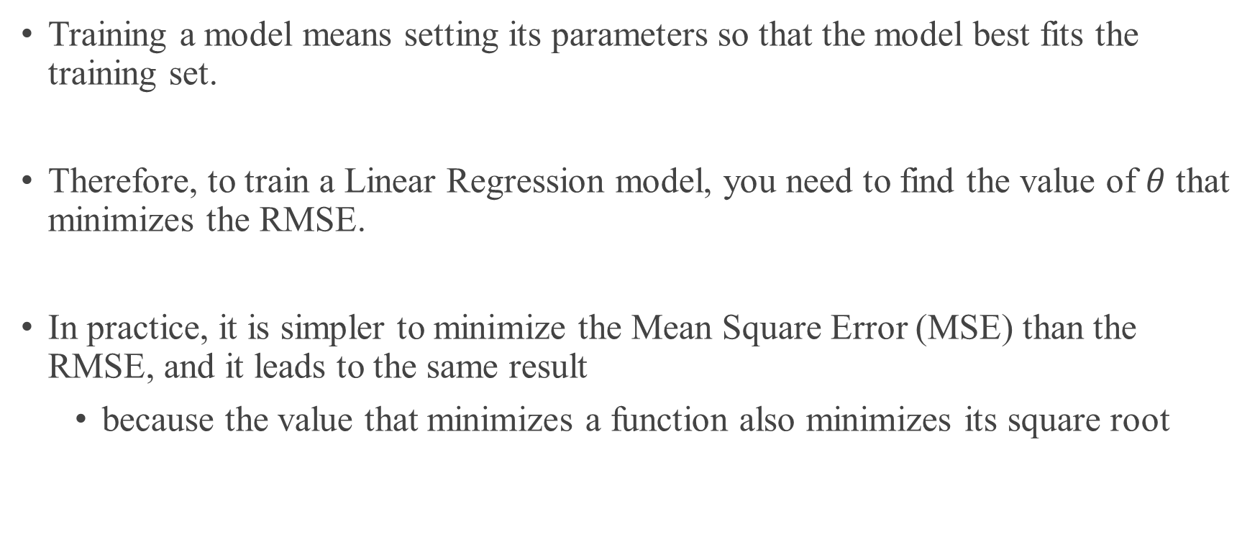
Train a Linear Model
Training a model means setting its parameters so that the model best fits the training set.
Therefore, to train a Linear Regression model, you need to find the value of $θ$ that minimizes the RMSE.
In practice, it is simpler to minimize the Mean Square Error (MSE) than the RMSE, and it leads to the same result
because the value that minimizes a function also minimizes its square root

Slide 12
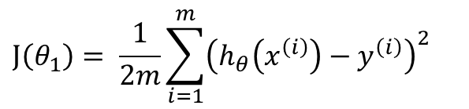
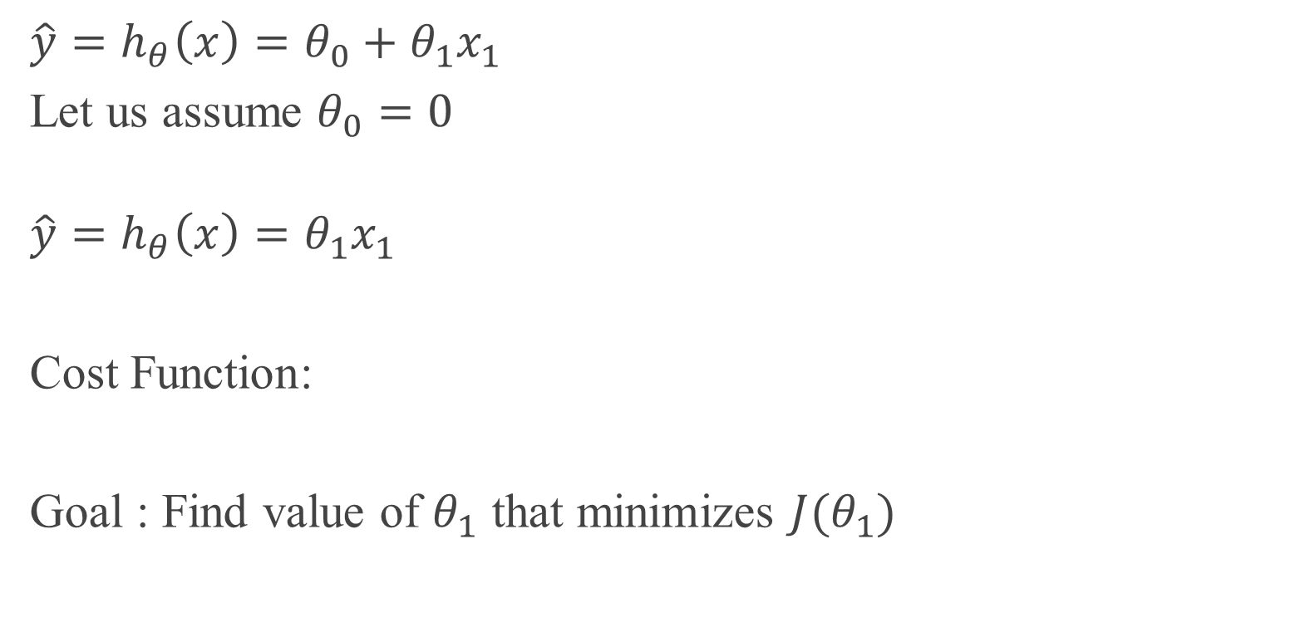
Cost Function
X | Y
1 | 1
2 | 2
3 | 3
$$\hat{y}=h_{θ}\left(x\right)=θ_{0}+θ_{1}x_{1}$$
Let us assume $θ_{0}=0$
$$\hat{y}=h_{θ}\left(x\right)=θ_{1}x_{1}$$
Cost Function:
Goal : Find value of $θ_{1}$ that minimizes $J(θ_{1})$
$$J\left(θ_{1}\right)= \frac{1}{2m}\sum_{i=1}^{m}{{\left(h_{θ}\left(x^{\left(i\right)}\right)−y^{\left(i\right)}\right)}^{2}}$$

Slide 13
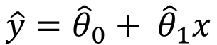
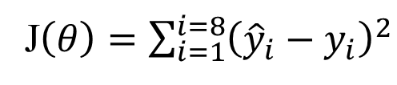
Linear Regression – 1 output, 1 input
$$y$$
$$(x_{8},y_{8})$$
$$(x_{6},y_{6})$$
$$(x_{7},y_{7})$$
$$(x_{4},y_{4})$$
$$(x_{5},y_{5})$$
$$(x_{2},y_{2})$$
$$(x_{3},y_{3})$$
$$(x_{1},y_{1})$$
$$x$$
Model:
$$\hat{y}={{\hat{θ}}_{0}+ \hat{θ}}_{1}x$$
J$\left(θ\right)=\sum_{i=1}^{i=8}{{\left({\hat{y}}_{i}−y_{i}\right)}^{2}}$

Slide 14
Linear Regression – 1 output, 1 input
Use training data to produce estimates of model parameters : $θ_{0}$and $θ_{1}$
Use training data to produce estimates of model parameters : 𝜃_0 and 𝜃_1
The prediction $\hat{y }$of $Y$on the basis of $X=x$is: $\hat{y}={{\hat{θ}}_{0}+ \hat{θ}}_{1}x$
The prediction (𝑦 ) ̂of 𝑌 on the basis of 𝑋=𝑥 is: 𝑦 ̂=〖𝜃 ̂_0+ 𝜃 ̂〗_1 𝑥
The hat symbol $^$ means estimated value of an unknown parameter, or the predicted value of the response
The hat symbol ^ means estimated value of an unknown parameter, or the predicted value of the response
We want to choose $θ_{0}$and $θ_{1}$that $\hat{y}$ is as close to all $y$ in $Y$ as possible.
We want to choose 𝜃_0 and 𝜃_1 that 𝑦 ̂ is as close to all 𝑦 in 𝑌 as possible.
Loss Function: Lower value indicated better model performance
J$\left(θ\right)=\sum_{i=1}^{i=8}{{\left({\hat{y}}_{i}−y_{i}\right)}^{2}}$ - Mean Squared error
J(𝜃)=∑_(𝑖=1)^(𝑖=8)▒(𝑦 ̂_𝑖−𝑦_𝑖 )^2 - Mean Squared error

Slide 15
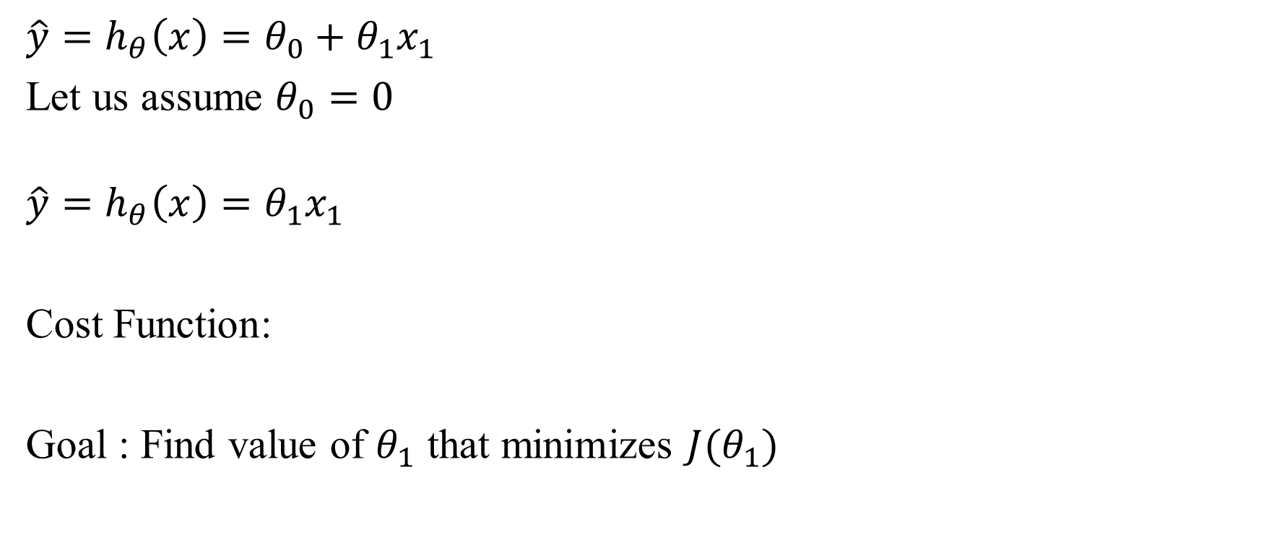
Loss Function
X | Y
1 | 1
2 | 2
3 | 3
$$\hat{y}=h_{θ}\left(x\right)=θ_{0}+θ_{1}x_{1}$$
Let us assume $θ_{0}=0$
$$\hat{y}=h_{θ}\left(x\right)=θ_{1}x_{1}$$
Cost Function:
Goal : Find value of $θ_{1}$ that minimizes $J(θ_{1})$
$$J\left(θ_{1}\right)= \frac{1}{2m}\sum_{i=1}^{m}{{\left(h_{θ}\left(x^{\left(i\right)}\right)−y^{\left(i\right)}\right)}^{2}}$$

Slide 16
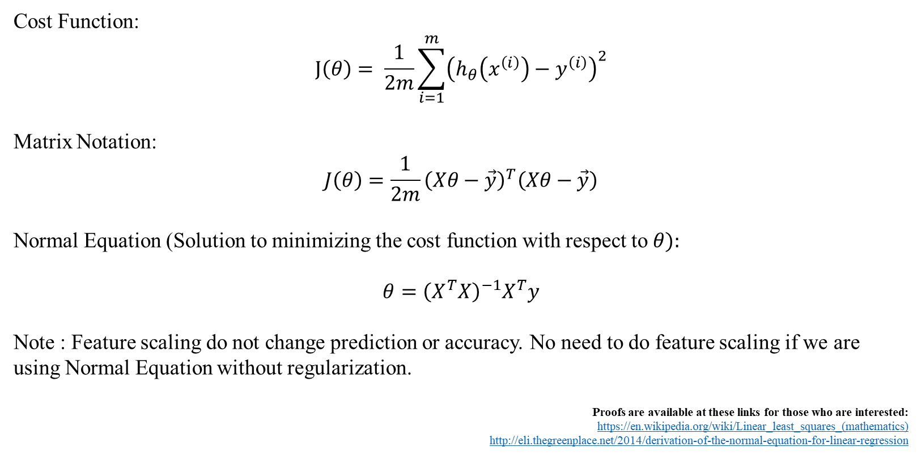
Least Squares Normal Equation
Cost Function:
$$J\left(θ\right)= \frac{1}{2m}\sum_{i=1}^{m}{{\left(h_{θ}\left(x^{\left(i\right)}\right)−y^{\left(i\right)}\right)}^{2}}$$
Matrix Notation:
$$J\left(θ\right)=\frac{1}{2m}{\left(Xθ−\vec{y}\right)}^{T}\left(Xθ−\vec{y}\right)$$
Normal Equation (Solution to minimizing the cost function with respect to $θ):$
$$θ={\left(X^{T}X\right)}^{−1}X^{T}y$$
Note : Feature scaling do not change prediction or accuracy. No need to do feature scaling if we are using Normal Equation without regularization.
Proofs are available at these links for those who are interested:
https://en.wikipedia.org/wiki/Linear_least_squares_(mathematics)
http://eli.thegreenplace.net/2014/derivation-of-the-normal-equation-for-linear-regression
Notes:
Matrix form?

Slide 17
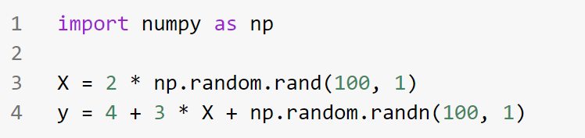
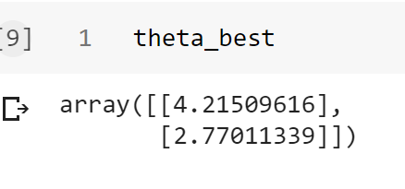
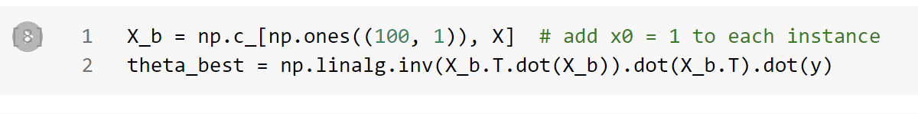
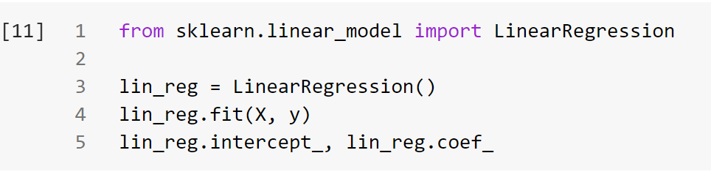
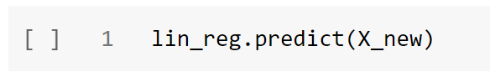
In Python
Numpy
Sklearn

Slide 18
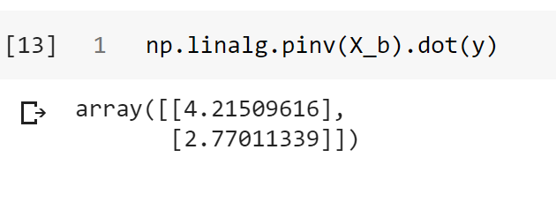
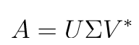
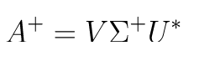
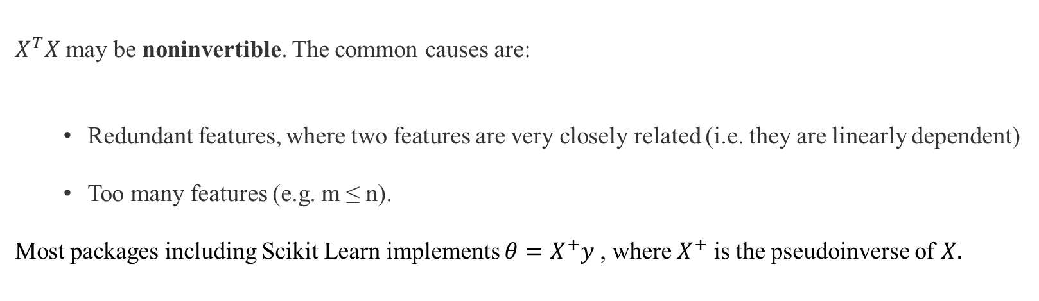
Least Squares Normal Equation
$X^{T}X$ may be noninvertible. The common causes are:
Redundant features, where two features are very closely related (i.e. they are linearly dependent)
Too many features (e.g. m ≤ n).
Most packages including Scikit Learn implements $θ=X^{+}y$, where $X^{+}$ is the pseudoinverse of $X.$
Pseudoinverse – using SVD
Notes:
Matrix form?

Slide 19
Normal Equation Pros and Cons
Cons:
The computational complexity of linear regression is very high
There is no controlling parameters
Pros:
Prediction is very fast

Slide 20
Gradient Descent

Slide 21
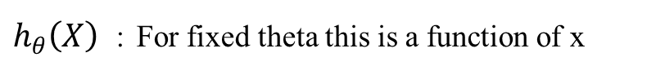
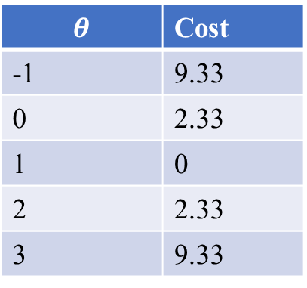
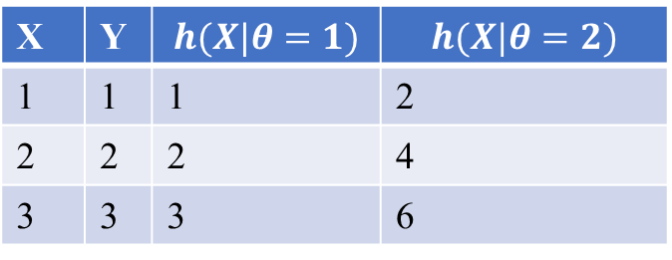
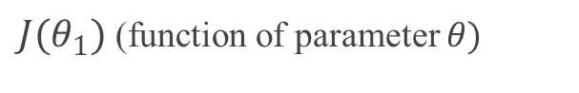
Loss Function
$h_{θ}\left(X\right)$ : For fixed theta this is a function of x
X | Y | $$h(X|θ=1)$$ | $$h(X|θ=2)$$
1 | 1 | 1 | 2
2 | 2 | 2 | 4
3 | 3 | 3 | 6
$J(θ_{1})$ (function of parameter $θ)$
$$θ$$ | Cost
-1 | 9.33
0 | 2.33
1 | 0
2 | 2.33
3 | 9.33
Convex Function

Slide 22
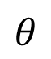
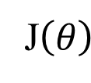
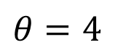
Gradient Descent (GD) (idea)
Start with a random value of $θ$(e.g. $θ=4$)
Start with a random value of 𝜃 (e.g. 𝜃=4)
Compute the gradient (derivative) of $J\left(θ\right)$at point $θ=4$.
Compute the gradient (derivative) of J(𝜃) at point 𝜃=4.
Recompute $θ$ as: $θ=θ−λ∗ gradient$
Recompute 𝜃 as: 𝜃=𝜃−𝜆∗ 𝑔𝑟𝑎𝑑𝑖𝑒𝑛𝑡
J$\left(θ\right)$
$$θ=4$$
$$θ$$

Slide 23
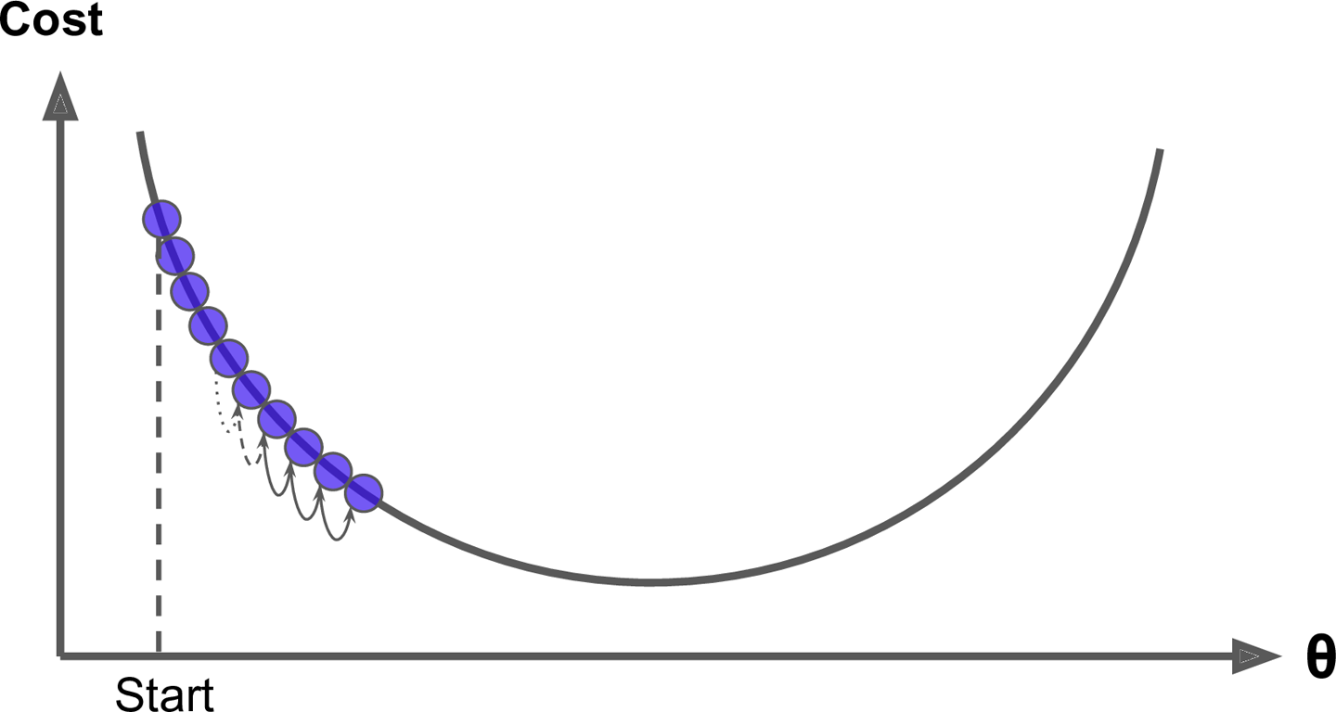
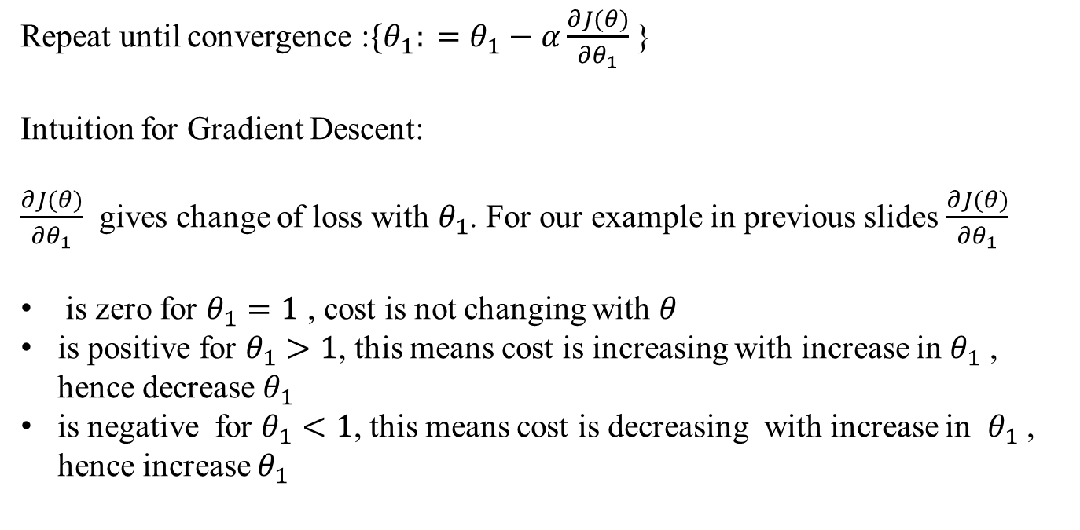
Gradient Descent
Repeat until convergence :${\{θ}_{1}: =θ_{1}−α\frac{∂J(θ)}{∂θ_{1}}$ }
Intuition for Gradient Descent:
$\frac{∂J(θ)}{∂θ_{1}}$ gives change of loss with $θ_{1}$. For our example in previous slides $\frac{∂J(θ)}{∂θ_{1}}$
is zero for $θ_{1}=1$ , cost is not changing with $θ$
is positive for $θ_{1}>1$, this means cost is increasing with increase in $θ_{1}$ , hence decrease $θ_{1}$
is negative for $θ_{1}<1$, this means cost is decreasing with increase in $θ_{1}$ , hence increase $θ_{1}$

Slide 24
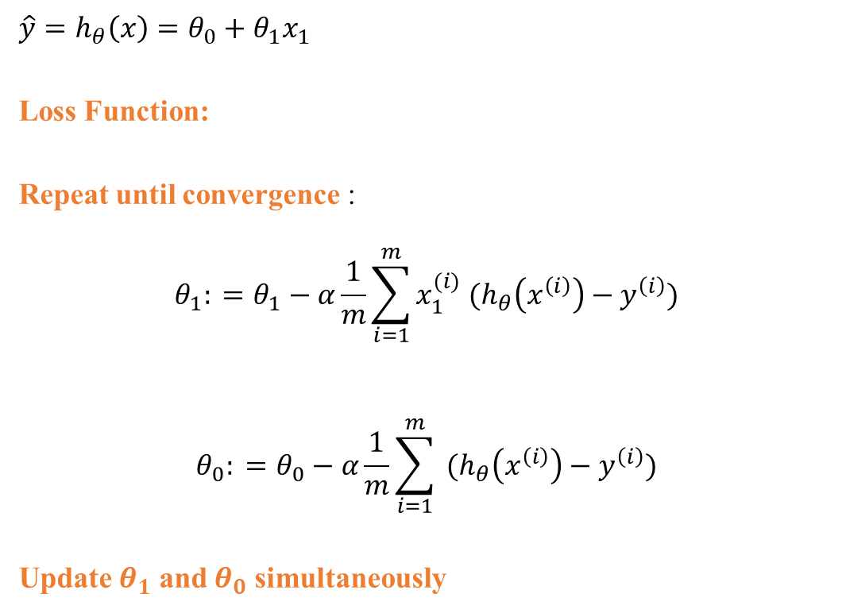
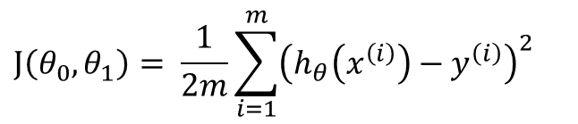
Gradient Descent- Two Parameters
$$\hat{y}=h_{θ}\left(x\right)=θ_{0}+θ_{1}x_{1}$$
Loss Function:
Repeat until convergence :
$$θ_{1}: =θ_{1}−α\frac{1}{m}\sum_{i=1}^{m}{{x_{1}^{(i)} (h}_{θ}\left(x^{\left(i\right)}\right)−y^{\left(i\right)})}$$
$$θ_{0}: =θ_{0}−α\frac{1}{m}\sum_{i=1}^{m}{{ (h}_{θ}\left(x^{\left(i\right)}\right)−y^{\left(i\right)})}$$
Update $θ_{1}$ and $θ_{0}$ simultaneously
$$J\left(θ_{0},θ_{1}\right)= \frac{1}{2m}\sum_{i=1}^{m}{{\left(h_{θ}\left(x^{\left(i\right)}\right)−y^{\left(i\right)}\right)}^{2}}$$
error
error
error

Slide 25










Gradient Descent- Two Parameters
$$λ=0.01$$
$$J\left(θ_{0},θ_{1}\right)= \frac{1}{2m}\sum_{i=1}^{m}{{\left(h_{θ}\left(x^{\left(i\right)}\right)−y^{\left(i\right)}\right)}^{2}}$$
Initialize $θ_{0}$ and $θ_{1}$ randomly
for e = 0, num_epochs do
Compute:
$$dJ(θ_{0},θ_{1})/dθ_{0}$$
and
$$dJ(θ_{0},θ_{1})/dθ_{1}$$
Update $θ_{0}$:
$$θ_{o}=θ_{0} −λdJ(θ_{0},θ_{1})/dθ_{0}$$
Update $θ_{1}$:
$$θ_{1}=θ_{1} −λdJ(θ_{0},θ_{1})/dθ_{1}$$
Print:
J$(θ_{0},θ_{1})$
// Useful to see if this is becoming smaller or not.
end
An epoch is one complete pass through the entire training dataset, during which the model's parameters are updated to minimize the loss of function.
Each Update is based on complete dataset

Slide 26

Effect of learning rate

Slide 27



Effect of learning rate - code

Slide 28

Pros and Cons
Advantages:
Simple and often quite effective on ML tasks
Often very scalable
Drawbacks
Might find a local minimum
Only applies to smooth function (differentiable)
Fortunately, the MSE cost function for a Linear Regression model happens to be a convex function, which means that if you pick any two points on the curve, the line segment joining them never crosses the curve.

Slide 29

Feature Scale
The cost function has the shape of a bowl, but it can be an elongated bowl if the features have very different scales.
Figure shows Gradient Descent on a training set where features 1 and 2 have the same scale (on the left), and on a training set where feature 1 has much smaller values than feature 2 (on the right)
Image source : Book - Hands-On Machine Learning with Scikit-Learn and TensorFlow: Concepts, Tools, and Techniques to Build Intelligent Systems

Slide 30

Gradient Descent- Two Parameters
expensive
$$λ=0.01$$
$$J\left(θ_{0},θ_{1}\right)= \frac{1}{2m}\sum_{i=1}^{m}{{\left(h_{θ}\left(x^{\left(i\right)}\right)−y^{\left(i\right)}\right)}^{2}}$$
Initialize $θ_{0}$ and $θ_{1}$ randomly
for e = 0, num_epochs do
Compute:
$$dJ(θ_{0},θ_{1})/dθ_{0}$$
and
$$dJ(θ_{0},θ_{1})/dθ_{1}$$
Update $θ_{0}$:
$$θ_{o}=θ_{0} −λdJ(θ_{0},θ_{1})/dθ_{0}$$
Update $θ_{1}$:
$$θ_{1}=θ_{1} −λdJ(θ_{0},θ_{1})/dθ_{1}$$
Print:
$$J(θ_{0},θ_{1})$$
end
An epoch is one complete pass through the entire training dataset, during which the model's parameters are updated to minimize the loss of function.
Each Update is based on complete dataset

Slide 31








Gradient Descent- Mini Batch
$$λ=0.01$$
Initialize $θ_{0}$ and $θ_{1}$ randomly
$$j\left(θ_{0},θ_{1}\right)= \frac{1}{2m}\sum_{iεB}{{\left(h_{θ}\left(x^{\left(i\right)}\right)−y^{\left(i\right)}\right)}^{2}}$$
for e = 0, num_epochs do
for b = 0, num_batches do
Compute:
$$dj(θ_{0},θ_{1})/dθ_{0}$$
and
$$dj(θ_{0},θ_{1})/dθ_{1}$$
Update $θ_{0}$:
$$θ_{o}=θ_{0} −λdj(θ_{0},θ_{1})/dθ_{0}$$
Update $θ_{1}$:
$$θ_{1}=θ_{1} −λdj(θ_{0},θ_{1})/dθ_{1}$$
Print:
j$(θ_{0},θ_{1})$
// Useful to see if this is becoming smaller or not.
end
An epoch is one complete pass through the entire training dataset, during which the model's parameters are updated to minimize the loss of function.
Each Update is based on a batch of observations

Slide 32
Gradient Descent Variations
Batch Gradient Descent
Mini Batch Gradient Descent
X1 | X2 | Y | Yhat | Error (e) | E * x1 | E * x2
1 update per epoch
All 12 observations will be used in each update of parameters
Let us say Batch size is 3
Gradient is calculated based on 3 observations
In an epoch, we will make 4 updates

Slide 33


Gradient Descent Variations
Batch Gradient Descent : Uses whole training data at every iteration
Stochastic Gradient Descent: Each step uses a random instance in the training set
Mini Batch Gradient Descent : Each step uses a subset of instance in the training set

Slide 34


Variations
Stochastic gradient descent
Mini batch gradient descent

Slide 35
Summary
Algorithm | Large m | Large n | Hyperparameter | Scaling required | sklearn
Normal Equation | Fast | Slow | 0 | No | n/a
SVD | Fast | Slow | 0 | No | LinearRegression
Batch GD | Slow | Fast | 2 | Yes | n/a
Stochastic GD | Fast | Fast | ≥2 | Yes | SGDRegressor
Mini-batch GD | Fast | Fast | ≥2 | Yes | n/a

Slide 36
Other Regressions

Slide 37



Polynomial Regression
Generate new features consisting of all polynomial combinations of the original features
A linear model
An application of non-linear transformations
$$X=\left(x_{0}, x_{1}\right) −→X^{′}=\left(x_{0},x_{1},x_{0}x_{1},x_{0}^{2},x_{1}^{2}\right)$$
$$Y=w_{0}x_{0}+w_{1}x_{1}+w_{01}x_{0}x_{1}+w_{00}x_{0}^{2}+w_{11}x_{1}^{2}$$

Slide 38


Example I: Polynomial Features

Slide 39


Example I: Polynomial Features

Slide 40

Example I: Polynomial Features

Slide 41
Model Generalization

Slide 42

Model Generalization
Model is trained on a training set
$\hat{y}$ is the estimate of actual output 𝑦
Error estimate $J_{in}$is obtained as sum of squared error or some other measure.
In-sample error
$$J_{in}= \frac{1}{2m}\sum_{i=1}^{m}{{\left(\hat{y}−y^{\left(i\right)}\right)}^{2}}$$
Here $m$ is number of observations in training set
How well $\hat{y}$ estimates the actual output 𝑦 on the data model is trained on?
Credit: C. Bishop. Pattern Recognition and Mach. Learning.

Slide 43


Test Set
Model is tested on test set
How well $\hat{y}$ estimates the actual output 𝑦 for this previously unseen data?
How does error measure $J_{test}$ differ from the error $J_{in}$obtained using training set?
Is the model able to generalize to data outside the training set?
$$J_{test}= \frac{1}{2m_{test}}\sum_{i=1}^{m_{test}}{{\left(\hat{y}−y^{\left(i\right)}\right)}^{2}}$$
Credit: C. Bishop. Pattern Recognition and Mach. Learning.

Slide 44






Underfitting
$f$ is linear
$f$ is cubic
$f$ is a polynomial of degree 9
The linear model suffers from “underfitting” (also called as high bias)
The model is limited in terms of its free parameters and cannot adapt to a complex target function “f”
Both in-sample (train) and test errors will be high
Credit: C. Bishop. Pattern Recognition and Mach. Learning.

Slide 45



Overfitting
$f$ is linear
$f$ is cubic
$f$ is a polynomial of degree 9
The ninth -order model (model-3) is performing what is known as “overfitting” (also known as high variance)
The model does not do well as it has more free parameters and fits the data more than is warranted. Essentially, the model is fitting to the noise in the training set
In-sample (train) error will be low, but test error will be high
Credit: C. Bishop. Pattern Recognition and Mach. Learning.

Slide 46
Generalization
Generalization ability refers to an algorithm's ability to give accurate predictions for new, previously unseen data.
Assumptions:
Future unseen data (test set) will have the same properties as the current training sets.
Thus, models that are accurate on the training set are expected to be accurate on the test set.
But that may not happen if the trained model is tuned too specifically to the training set.
Models that are too complex for the amount of training data available are said to overfit and are not likely to generalize well to new examples.
Models that are too simple, that don't even do well on the training data, are said to underfit and also not likely to generalize well.

Slide 47

Generalization
Overfitting
Low test score, high train score
Complex models
Under fitting
Low test and train score

Slide 48





Need for Validation Set
Data
Dog
Dog
Algorithm f(x)
Label?
Not dog
Training data
Validation data
Test data
Data
Machine
Learning
Rules
Classical Programming
Rules
Answers
Answers
Data

Slide 49




Need for Validation Set
Model:
$$\hat{y}=θ_{n}x^{n}+…+θ_{1}x+θ_{0}$$
How do we select n ?
$f$ is linear
$f$ is cubic
$f$ is a polynomial of degree 9
Credit: C. Bishop. Pattern Recognition and Mach. Learning.

Slide 50

Need for Validation Set
We cannot use test set – test error now is optimistically biased as the learning algorithm has been tuned for the best performance using test set.
Need a separate set if we need to do any form of model selection –in ML literature, we refer to this set as a “validation” set (or cross-validation set)
We try to minimize $J_{val}$for the purposes of model selection
Credit: C. Bishop. Pattern Recognition and Mach. Learning.

Slide 51

Data Division- Summary
Training dataset: the sample of data used to fit the model
Validation Dataset: the sample of data used to provide an unbiased evaluation of a model fit on the training dataset while tuning model hyperparameters.
Test Dataset: a set of examples used only to assess the performance (i.e. generalization) of a fully specified classifier
Data
Machine
Learning
Rules
Answers
Rules
Classical Programming
Answers
Data

Slide 52

Learning Curves
How test and training error changes with size of data set?

Slide 53


Learning Curves

Slide 54


Learning Curves

Slide 55
Learning Curves- Underfitting
Training error is small at first and grows
Training error becomes close to cross validation
So the performance of the cross validation and training sets end up being similar (but very poor)
If a learning algorithm is suffering from underfitting, more data will not help

Slide 56
Learning Curves-Overfitting
When training set is small, training error is small too
• As training set size increases, training error is still small but slowly increases
Validation Error remains high, even when you have a moderate number of examples
An indicative diagnostic that you overfitting is that there's a big gap between training error and cross validation error
If a learning algorithm is suffering from overfitting, more data is probably going to help.

Slide 57
Regularization
Goal: optimize some combination of fit and simplicity
Penalize the magnitude of coefficients of features
Minimize the error between predicted and actual examples
Early stopping (for gradient descent):
Ridge Regression:
L2-norm: adds penalty equivalent to square of the magnitude of coefficients
Lasso Regression:
L1-norm: adds penalty equivalent to absolute value of the magnitude of coefficients

Slide 58


Regularization- Early Stopping

Slide 59
Regularization- Early Stopping

Slide 60

Regularization- Early Stopping

Slide 61

Regularization- Early Stopping

Slide 62
Large coefficient
What does a large coefficient signify?
It means that we’re putting a lot of emphasis on that feature, i.e. the particular feature is a good predictor for the outcome.
When it becomes too large, the algorithm starts modelling intricate relations to estimate the output and ends up overfitting to the particular training data.

Slide 63

Ridge Regression
A regularization term will be added to the cost function
$$J\left(θ\right)=MSE\left(θ\right)+\frac{λ}{2}\sum_{i=1}^{n}{θ_{i}^{2}}$$
$J\left(θ\right)=\frac{1}{2m}{\left(Xθ−\vec{y}\right)}^{T}\left(Xθ−\vec{y}\right)+\frac{λ}{2}{\left(θ⊙l\right)}^{T}\left(θ⊙l\right), l=\left[\begin{aligned}0 \\ 1 \\ 1 \\ ⋮ \\ 1\end{aligned}\right]$ and $⊙$ is hadamard product (elementwise multiplication)
The tuning parameter $λ$serves to control the relative impact of these two terms on the regression coefficient estimate.
Selecting a good value for $λ$is critical.

Slide 64


Hyper parameter : $λ$
$λ=0$:
The objective becomes same as simple linear regression.
We’ll get the same coefficients as simple linear regression.
$λ=∞$:
The coefficients will be zero. Why? Because of infinite weightage on square of coefficients, anything less than zero will make the objective infinite.
$$<0<λ<∞$$
The magnitude of α will decide the weightage given to different parts of objective.
The coefficients will be somewhere between 0 and ones for simple linear regression.

Slide 65

Ridge Regression

Slide 66



Solutions Ridge
Normal Equation:
$$θ={\left(X^{T}X+λL\right)}^{−1}X^{T}y,$$
$$L=\left|\begin{matrix}0 & & \\ & 1 & \\ & & \begin{matrix}. & & \\ & . & \\ & & 1\end{matrix}\end{matrix}\right|$$
L is a matrix with 0 at the top left and 1's down the diagonal, with 0's everywhere else. It has same dimensions as $X^{T}X$. If $m(observations≤n$(features), then $X^{T}X$ is not invertible but $X^{T}X+λ.L$ is invertible
Gradient Descent:
Repeat until convergence :$\left\{\begin{aligned}θ_{0}: =θ_{0}−\frac{α}{m}\sum_{i=1}^{m}{{x_{j}^{(i)} (h}_{θ}\left(x^{\left(i\right)}\right)−y^{\left(i\right)})} \\ θ_{j}: =θ_{j}−α\left[\left(\frac{1}{m}\sum_{i=1}^{m}{{x_{j}^{(i)} (h}_{θ}\left(x^{\left(i\right)}\right)−y^{\left(i\right)})}\right)+\frac{λ}{m}θ_{j}\right] for j ∈\left\{1,2…n\right\}\end{aligned}\right\}$
Matrix Notation:
$θ ≔θ −\frac{α}{m}\left[X^{T}(Xθ−\vec{y}\text{) }+λ\left(θ⊙l\right)\right]$, $l=\left[\begin{aligned}0 \\ 1 \\ 1 \\ ⋮ \\ 1\end{aligned}\right]$ and $⊙$ is hadamard product (elementwise multiplication).

Slide 67



Ridge - Sklearn
Here alpha is same as lambda in previous slides
You can specify alpha and learning rate as hyperparameters as well

Slide 68

Ridge – effect on co-efficients

Slide 69


Ridge - Sklearn

Slide 70

Ridge - Sklearn

Slide 71

Ridge – Learning Curves

Slide 72

Lasso
Least Absolute Shrinkage and Selection Operator Regression
$$J\left(θ\right)=MSE\left(θ\right)+λ\sum_{i=1}^{n}{|θ_{i}|}$$
Lasso combines some of the shrinking advantages of ridge with variable selection
The L1 penalty has the effects of forcing some coefficient estimates to be exactly equal to zero
Tip: Techniques such as cross validation are recommended to determine which approach is better on a particular dataset

Slide 73

Solutions Lasso
No Closed firm solution
Scikit Learn uses Coordinate Descent Algorithm (beyond scope of this course)
Gradient Descent (approximate solution using sub-gradient):
$$θ ≔θ −α\left[{\frac{1}{m}X}^{T}(Xθ−\vec{y}\text{) }+λ sign(θ)\right]$$
$$sign\left(θ\right)=\left[\begin{aligned}0 \\ sign(θ_{1}) \\ sign(θ_{2}) \\ ⋮ \\ sign(θ_{n})\end{aligned}\right]$$
$$where sign\left(θ_{j}\right)=\left\{\begin{aligned}−1 if θ_{j}<0 \\ 0 if θ_{j}=0 \\ + 1 if θ_{j}>1 \end{aligned}\right.$$

Slide 74


Lasso-sklearn
You can specify alpha and learning rate as hyperparameters as well

Slide 75

L1 vs L2

Slide 76

L1 vs L2

Slide 77
Key Difference
Ridge: It includes all (or none) of the features in the model. Thus, the major advantage of ridge regression is coefficient shrinkage and reducing model complexity.
Lasso: Along with shrinking coefficients, lasso performs feature selection as well. As we observed earlier, some of the coefficients become exactly zero, which is equivalent to the particular feature being excluded from the model.

Slide 78
Typical Use Cases
Ridge: It is majorly used to prevent overfitting. Since it includes all the features, it is not very useful in case of exorbitantly high number features, say in millions, as it will pose computational challenges.
Lasso: Since it provides sparse solutions, it is generally the model of choice (or some variant of this concept) for modelling cases where the number features are in millions or more. In such a case, getting a sparse solution is of great computational advantage as the features with zero coefficients can simply be ignored.

Slide 79
Presence of Highly Correlated Features
Ridge: It generally works well even in presence of highly correlated features as it will include all of them in the model but the coefficients will be distributed among them depending on the correlation.
Lasso: It arbitrarily selects any one feature among the highly correlated ones and reduced the coefficients of the rest to zero. Also, the chosen variable changes randomly with change in model parameters. This generally doesn’t work that well as compared to ridge regression.

Slide 80



ElasticNet
We can add both L1 and L2 terms to the cost function as well :
$$J\left(θ\right)=MSE\left(θ\right)+rλ\sum_{i=1}^{n}{\left|θ_{i}\right|+\frac{\left(1−r\right)λ}{2}\sum_{i=1}^{n}{θ^{2}}}$$

Slide 81
Key Takeaways

Slide 82
Gradient Descent
Calculate Loss
Calculate Gradients
Initialize weights
Predict
Update Weights
Stop
Goal: Optimize model performance by finding suitable weights.
Define a loss function - a lower value indicates better model performance.
Calculate gradients - these represent the change in loss with respect to weights. Positive gradients imply a decrease in weight to minimize loss, while negative gradients indicate an increase in weight.
Utilize gradients to guide weight adjustments, leading to continuous improvement in model performance.

Slide 83
Model Geenralization
Train a model that so that it can make good predictions on unseen data.
Overfitting:
Training error is small, validation error is large
Get more data so that model can learn underlying patterns instead of remembering the data
Reduce model complexity
Regularization – Add noise to inputs so that model becomes robust to small variations
Underfitting:
Training error is large, validation error is large
Model does not have capacity, adding more data will not help
Increase model complexity
Try to fit model without any regularization

Slide 84









Binary Classification (pick one from two labels)
$$\hat{y}=b+w_{1}x_{1}+w_{2}x_{2}+ ⋯+w_{n}x_{n}$$
Dog or No Dog
C = 2
Samples
$$x_{1}$$
Labels
$$[1]$$
$$[0]$$
$$[0]$$
$$x_{2}$$

Slide 85
Math (Logistic Regression)
$p$: probability of class “1”
𝑝: probability of class “1”
Need to relate $p$ to predictors with a function that guarantees $0≤p≤1$
Need to relate 𝑝 to predictors with a function that guarantees 0≤𝑝≤1
The standard linear function does not
Fix: logistic response function (logit/sigmoid)
$$\hat{z}=\hat{b}+{\hat{w}}_{1}x_{1}+{\hat{w}}_{2}x_{2}+ ⋯+{\hat{w}}_{n}x_{n}$$
𝑧 ̂=𝑏 ̂+𝑤 ̂_1 𝑥_1+𝑤 ̂_2 𝑥_2+ ⋯+𝑤 ̂_𝑛 𝑥_𝑛
$$\hat{p}=σ(\hat{z})=\frac{e^{\hat{z}}}{1+e^{\hat{z}}}=\frac{1}{1+e^{−\hat{z}}}$$
𝑝 ̂=𝜎(𝑧 ̂)=𝑒^𝑧 ̂ /(1+𝑒^𝑧 ̂ )=1/(1+𝑒^(−𝑧 ̂ ) )

Slide 86

Logit (Sigmoid) Function
Logit (sigmoid) function is a function that returns the result between 0 and 1.
Prediction $\hat{y}=\left\{\begin{aligned}0 if \hat{p}<threshold \\ 1 if \hat{p}≥threshold \end{aligned}\right.$, typically, $threshold$ = 0.5
Prediction 𝑦 ̂={█(0 𝑖𝑓 𝑝 ̂<𝑡ℎ𝑟𝑒𝑠ℎ𝑜𝑙𝑑@1 𝑖𝑓 𝑝 ̂≥𝑡ℎ𝑟𝑒𝑠ℎ𝑜𝑙𝑑 )┤, typically, 𝑡ℎ𝑟𝑒𝑠ℎ𝑜𝑙𝑑 = 0.5
$$\hat{p}<0.5 , when z<0$$
𝑝 ̂<0.5 , 𝑤ℎ𝑒𝑛 𝑧<0
$$\hat{p}≥0.5 when z≥0$$
𝑝 ̂≥0.5 𝑤ℎ𝑒𝑛 𝑧≥0
This means Logistic Regression predicts 1 if $z$ is positive and 0 if it is negative
This means Logistic Regression predicts 1 if 𝑧 is positive and 0 if it is negative

Slide 87


Binary Cross Entropy Loss/Logistic Loss function
Loss function single training instance :
$$c\left(θ\right)=\left\{\begin{aligned}−\log\left(\hat{ p}\right) if y=1 \\ −\log\left(1−\hat{p}\right) if y=0 \end{aligned}\right.$$
Alternatively:
$$c\left(θ\right)=−y\log\left(\hat{p}\right)−\left(1−y\right)\log\left(1−\hat{p}\right)$$
The cost function over the whole triaging set:
$$J\left(θ\right)=−\frac{1}{m}\sum_{i=1}^{m}{\left[y^{(i)}\log\left({\hat{p}}^{(i)}\right)+(1−y^{(i)})\log\left(1−{\hat{p}}^{(i)}\right)\right]}$$
Intuition
$c\left(θ\right)=0 , if \hat{p}=y$,
$c\left(θ\right)→∞,$ if $y=1 and \hat{p}→0$
$c\left(θ\right)→∞,$ if $y=0 and \hat{p}→1$
Intuition: Minimizing the loss will maximize the probability of the true label (class)

Slide 88




Logistic Regression Summary
$$\hat{p}$$
$$\hat{y}$$
Function to convert Output to Probability : Sigmoid
Prediction $\hat{y}=\left\{\begin{aligned}0 if \hat{z}<0 \\ 1 if \hat{z}≥0\end{aligned}\right. =\left\{\begin{aligned}0 if \hat{p}<0.5 \\ 1 if \hat{p}≥0.5\end{aligned}\right.$
Prediction 𝑦 ̂={█(0 𝑖𝑓 𝑧 ̂<0@1 𝑖𝑓 𝑧 ̂≥0)┤ ={█(0 𝑖𝑓 𝑝 ̂<0.5@1 𝑖𝑓 𝑝 ̂≥0.5)┤
Loss Function : Binary Cross Entropy Loss (Logistic Loss Function)
Number of Outputs: One

Slide 89


Gradient Descent Logistic Regression
Repeat until convergence :${\{θ}_{j}: =θ_{j}−α\frac{1}{m}\sum_{i=1}^{m}{x_{j}^{\left(i\right)}({\hat{p}}^{(i)}−y^{\left(i\right)})}$ for j: = 0…n}, where ${\hat{p}}^{(i)}= σ\left(θ^{T}x^{\left(i\right)}\right)$
Vector format :
$$θ≔θ−\frac{α}{m}X^{T}(σ\left(Xθ\right)−\vec{y})$$

Slide 90


Logistic Regression- Regularization
We can use both L1 and L2 regularization for logistic regression

Slide 91

Logistic Regression- Regularization

Slide 92









Multiclass Classification (Softmax Regression)
(pick one from more than two labels)
Binary Classification
Multi-class Classification
Dog or No Dog
Dog or Cat or Hen
C = 2
Samples
C = 3
Samples
Labels
Labels
$$[1]$$
$$[0]$$
$$[0]$$
$$[100]$$
$$[010]$$
$$[001]$$
$$x_{1}$$
$$x_{1}$$
$$x_{2}$$
$$x_{2}$$

Slide 93
Multiclass Classification (Softmax Regression)
(pick one from more than two labels)
Generalization of Logistic regression:
${\hat{z}}_{k}(x) = {\hat{\text{b}}}^{k}+ {\hat{w}}_{1}^{k}x_{1}+…+{\hat{w}}_{n}^{k}x_{n}$, each class has set of weights and bias.
Generalization of Logistic regression:
𝑧 ̂_𝑘 (𝑥) =" " "b" ̂^𝑘+ 𝑤 ̂_1^𝑘 𝑥_1+…+𝑤 ̂_𝑛^𝑘 𝑥_𝑛, each class has set of weights and bias.
Softmax Function:
${\hat{p}}_{k}=\frac{e^{z_{k}\left(x\right)}}{\sum_{j=1}^{k}{e^{z_{j}(x)}}}$ $,{for k=2: p}_{1}=\frac{e^{z_{1}\left(x\right)}}{e^{z_{1\left(x\right)}}+e^{z_{2\left(x\right)}}},p_{2}=\frac{e^{z_{2}\left(x\right)}}{e^{z_{1\left(x\right)}}+e^{z_{2\left(x\right)}}}$
Softmax Function:
𝑝 ̂_𝑘=𝑒^(𝑧_𝑘 (𝑥) )/(∑_(𝑗=1)^𝑘▒𝑒^(𝑧_𝑗 (𝑥)) ) ,〖𝑓𝑜𝑟 𝑘=2: 𝑝〗_1=𝑒^(𝑧_1 (𝑥) )/(𝑒^(𝑧_1(𝑥) )+𝑒^(𝑧_2(𝑥) ) ),𝑝_2=𝑒^(𝑧_2 (𝑥) )/(𝑒^(𝑧_1(𝑥) )+𝑒^(𝑧_2(𝑥) ) )
$$\hat{y}=\underset{k}{argmax} {\hat{z}}_{k}(x)=\underset{k}{argmax} {\hat{p}}_{k}(x)$$
𝑦 ̂=(𝑎𝑟𝑔𝑚𝑎𝑥)┬𝑘 𝑧 ̂_𝑘 (𝑥)=(𝑎𝑟𝑔𝑚𝑎𝑥)┬𝑘 𝑝 ̂_𝑘 (𝑥)

Slide 94


Negative Log Likelihood Loss/Cross Entropy Loss
$$J\left(θ\right)=−\frac{1}{m}\sum_{i=1}^{m}{\sum_{k=1}^{K}{y_{k}^{\left(i\right)}}}log({\hat{p}}_{k}^{(i)})$$
For two classes:
$$J\left(θ\right)=−\frac{1}{m}\sum_{i=1}^{m}{y_{1}^{(i)}log}\left({\hat{p}}_{1}^{(i)}\right)+y_{2}^{(i)}log({\hat{p}}_{2}^{(i)})$$
$$y_{2}=1−y_{1}$$
$$p_{2}=1−p_{1}$$
$$J\left(θ\right)=−\frac{1}{m}\sum_{i=1}^{m}{\left[y^{(i)}\log\left({\hat{p}}^{(i)}\right)+(1−y^{(i)})\log\left(1−{\hat{p}}^{(i)}\right)\right]}$$
Binary Cross Entropy Loss

Slide 95


Negative Log Likelihood Loss/Cross Entropy Loss
$$J\left(θ\right)=−\frac{1}{m}\sum_{i=1}^{m}{\sum_{k=1}^{K}{y_{k}^{\left(i\right)}}}log({\hat{p}}_{k}^{(i)})$$
Example for two observations, m = 2 and two classes, k = 2
Observation # 1
Observation # 2
Intuition: Minimizing the loss will maximize the probability of the true label (class)

Slide 96



Multiclass Classification as a Single-layer Neural Network
$$\hat{p}$$
$$\hat{y}$$
1
0
0
0
Probabilities will sum to 1
One for each output
Number of Outputs: Number of Classes
Function to convert Output to Probability: Softmax Function
Prediction $\hat{y}=\underset{k}{argmax} z_{k}\left(x\right) (Class which has the maximum probbaility value or z_{k} value)$
Prediction 𝑦 ̂=(𝑎𝑟𝑔𝑚𝑎𝑥)┬𝑘 𝑧_𝑘 (𝑥) (𝐶𝑙𝑎𝑠𝑠 𝑤ℎ𝑖𝑐ℎ ℎ𝑎𝑠 𝑡ℎ𝑒 𝑚𝑎𝑥𝑖𝑚𝑢𝑚 𝑝𝑟𝑜𝑏𝑏𝑎𝑖𝑙𝑖𝑡𝑦 𝑣𝑎𝑙𝑢𝑒 𝑜𝑟 𝑧_𝑘 𝑣𝑎𝑙𝑢𝑒)
Loss Function : Cross Entropy Loss

Slide 97



Binary Classification with Softmax and Cross Entropy Loss function
$$\hat{p}$$
$$\hat{y}$$
0
1
Number of Outputs: Two
Function to Convert Output to Probability: Softmax Function
Prediction $\hat{y}=\underset{k}{argmax} z_{k}\left(x\right) (Class which has the maximum probbaility value or z_{k} value)$
Prediction 𝑦 ̂=(𝑎𝑟𝑔𝑚𝑎𝑥)┬𝑘 𝑧_𝑘 (𝑥) (𝐶𝑙𝑎𝑠𝑠 𝑤ℎ𝑖𝑐ℎ ℎ𝑎𝑠 𝑡ℎ𝑒 𝑚𝑎𝑥𝑖𝑚𝑢𝑚 𝑝𝑟𝑜𝑏𝑏𝑎𝑖𝑙𝑖𝑡𝑦 𝑣𝑎𝑙𝑢𝑒 𝑜𝑟 𝑧_𝑘 𝑣𝑎𝑙𝑢𝑒)
Loss Function : Cross Entropy Loss

Slide 98

Multiclass Classification: One-vs-all
If there are $K$classes in output, fit $K$binary logistic regressions
Choose one class and then lump all the others into a single second class. Do this repeatedly, applying binary logistic regression to each case. For each observation, the class with the highest predicted probability is the prediction for that observation.

Slide 99



MultiClass Classification – One vs All
$$\hat{p}$$
$$\hat{y}$$
0
0
1
0
Probabilities will not sum to 1
Number of Outputs: Number of Classes
Example Function to convert Output to Probability: Sigmoid
Prediction $\hat{y}=\underset{k}{argmax} z_{k}\left(x\right) (Class which has the maximum probbaility value or z_{k} value)$
Prediction 𝑦 ̂=(𝑎𝑟𝑔𝑚𝑎𝑥)┬𝑘 𝑧_𝑘 (𝑥) (𝐶𝑙𝑎𝑠𝑠 𝑤ℎ𝑖𝑐ℎ ℎ𝑎𝑠 𝑡ℎ𝑒 𝑚𝑎𝑥𝑖𝑚𝑢𝑚 𝑝𝑟𝑜𝑏𝑏𝑎𝑖𝑙𝑖𝑡𝑦 𝑣𝑎𝑙𝑢𝑒 𝑜𝑟 𝑧_𝑘 𝑣𝑎𝑙𝑢𝑒)
Loss Function : Binary Cross Entropy Loss (Logistic Loss Function)

Slide 100










Multilabel Classification
Binary Classification
Multi-class Classification
Multi-label Classification
Dog or No Dog
Dog or Cat or Hen
Dog or Cat or Hen
C = 2
Samples
C = 3
Samples
C = 3
Samples
Labels
Labels
Labels
$$[1]$$
$$[0]$$
$$[0]$$
$$[100]$$
$$[010]$$
$$[001]$$
$$[110]$$
$$[011]$$
$$[101]$$
$$x_{1}$$
$$x_{1}$$
$$x_{1}$$
$$x_{2}$$
$$x_{2}$$
$$x_{2}$$

Slide 101
Multilabel Classification
$$\hat{p}$$
$$\hat{y}$$
1
0
1
0
Probabilities will not sum to 1
Number of Outputs: Number of Classes
Example Function to convert Output to Probability: Sigmoid
Prediction $\hat{y}=\left\{\begin{aligned}0 if \hat{z}<0 \\ 1 if \hat{z}≥0\end{aligned}\right. =\left\{\begin{aligned}0 if \hat{p}<0.5 \\ 1 if \hat{p}≥0.5\end{aligned}\right.$
Prediction 𝑦 ̂={█(0 𝑖𝑓 𝑧 ̂<0@1 𝑖𝑓 𝑧 ̂≥0)┤ ={█(0 𝑖𝑓 𝑝 ̂<0.5@1 𝑖𝑓 𝑝 ̂≥0.5)┤
Loss Function : Binary Cross Entropy Loss (Logistic Loss Function)

Slide 102

Linear Classifiers
Predictions in all the previous models can be made based on:
$${\hat{z}}_{k}(x) = {\hat{\text{b}}}^{k}+ {\hat{w}}_{1}^{k}x_{1}+…+{\hat{w}}_{n}^{k}x_{n}$$
Output equation given x₁ and x₂, is the equation of a line
w₁x₁ + w₂x₂ + b = 0
(in standard linear format: x₂ = (−w₁/w₂)x₁ + (−b/w₂) )
This line acts as a decision boundary
0 if input is on one side of the line
1 if on the other side of the line

Slide 103
Acknowledgement
Python Code for this presentation will be available on eLearning – code_presentation.ipynb (next lecture)
code_presentation.ipynb- The source code for this file is adapted from git hub repository of chapter 4 of the book
Hands-on Machine Learning with Scikit-Learn, Keras and TensorFlow
Git hub of book - https://github.com/ageron/handson-ml2

